Slide 1
Brewer’s Conjecture and the Feasibility of Consistent, Available, Partition-Tolerant Web Services
Based on the paper by Seth Gilbert, Nancy Lynch, MIT
Presenters: Urmil Chandarana, Aryan Hamine, Sudarsan Srivathsun

Slide 2
Background
At PODC 2000, Eric Brewer proposed a conjecture that it is impossible for a web service to provide the following 3 guarantees:
Consistency
Availability
Partition-tolerance
All these 3 services are desirable but having all 3 at once might prove to be unrealistic.

Slide 3
Real World Example
Imagine two ATMs (one in Davis and one in New York) sharing the same account. If the connection between them breaks, should both still work?”
•⁠ ⁠If yes → data may become inconsistent.
•⁠ ⁠If no → one ATM becomes unavailable.

Slide 4
Motivation
To formally prove Eric Brewer's 2000 conjecture that a conflict exists between 3 essential properties of distributed systems.
To explore practical solutions to this conflict, beyond the simple "pick two of three" trade-of

Slide 5
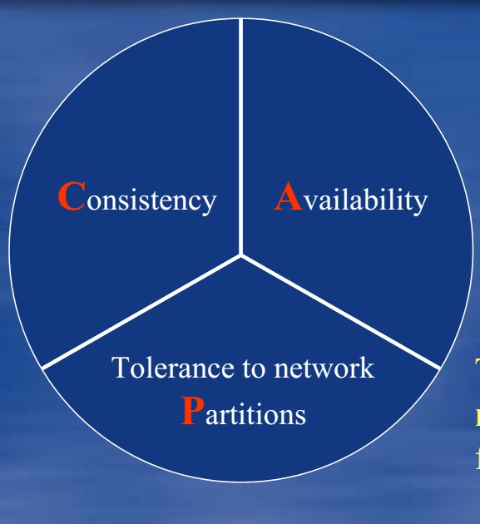
CAP Conjecture
Consistency : Every read reflects latest write
Availability: Request to a non-failing node always returns a response
Partition-Tolerance: System survives network failures
This Photo by Unknown Author is licensed under CC BY-SA

Slide 6
Types of Networks
Asynchronous: Messages may eventually be delivered, but there is no upper bound or guarantee if the message will be delivered and how long delivery will take. No clocks present. Nodes makes decision based on the order of message received.
Synchronous: Known fixed upper bound on the time it takes for a message to be delivered.
Partially Synchronous: Network may be asynchronous for some unknown period, but will eventually stabilize, after which a bound on message delivery time holds.

Slide 7
Impossibility Result - Asynchronous Networks
Theorem 1 - It is impossible in the asynchronous network model to implement a read/write data object that guarantees the following properties:
Availability
Atomic Consistency
in all fair executions (including those in which messages are lost).

Slide 8
Impossibility Result – Continued...
G1
G2
v0
v1
v0
v0
V1
write
read
α1
α2

Slide 9
Corollary 1.1
It is impossible in the asynchronous network model to implement a read/write data object that guarantees the following properties:
Availability, in all fair executions,
Atomic consistency, in fair executions in which no messages are lost.

Slide 10
Corollary 1.1 - Continued
Theorem 1 Proved: You can't have Consistency (C), Availability (A), and Partition-Tolerance (P) all at once, especially when messages are lost.
The natural next question is, "OK, but what if I'm not in a partition? What if I promise to be Consistent only when the network is perfect and no messages are lost?"
The Corollary's Answer: The paper says, "Nice try, but that's also impossible."

Slide 11
Corollary 1.1 - Indistinguishable
Case A: Message gets Lost
Case B: Message gets delayed
Server 1
Server 2
Server 1
Server 2
Request
Request
Response
t >>> t(exp)
Response

Slide 12
`In all Fair Execution` - Recap
"in all fair executions" refers to scenarios where any message that is sent is guaranteed to eventually be delivered, even if it is arbitrarily delayed.
Theorem 1 proves you can't have C, A, and P in executions where messages are lost.
Corollary 1.1 addresses a scenario where we lighten the restriction on atomic consistency by stating `in fair executions where no messages are lost, just delayed`.
The proof explains that this is still impossible because an asynchronous system can't tell the difference between a permanently lost message and one that is just "arbitrarily delayed"

Slide 13
Asynchronous Model - Solutions
Atomic, Partition Tolerant: These systems sacrifice availability. During a partition, to avoid returning inconsistent data, the system may stop responding to requests.
Atomic, Available: This is possible only if you assume there will be no network partitions. This model is often used for systems running on highly reliable local area networks (LANs).
Available, Partition Tolerant: These systems sacrifice strong consistency. They will always respond, but during a partition, they might return stale data.

Slide 14
Revamp – Partially Synchronous Model
In a real-world scenario, realise that most networks aren't asynchronous.
If we allow each node to have a clock, possibility of building a system increases.
The clocks themselves are not synchronized, in that they may display diﬀerent values at the same real time.
Assumptions:
every message is either delivered within a given, known time: t(msg) or its lost.
every node processes a received message within a given, known time: t(local), and local processing takes zero time.

Slide 15
Global Stabilization Time
A key distinction between fully asynchronous and partially synchronous networks is the existence of a Global Stabilization Time (GST) — a theoretical boundary after which the system becomes "well-behaved"
After GST :
Message delays and process speeds are bounded
Nodes can rely on timeouts and time-based coordination
The system recovers from asynchrony, enabling progress while preserving safety
In contrast, before GST, the system behaves like a fully async network — with unpredictable delays and no reliable notion of time.

Slide 16



Analogy for GST
GST Boundary makes the network synchronous
Synchronous Phase of the network:
Time bound messages
Node's can rely on internal clock
Asynchronous Phase of the Network :
Indefinite delays
No time bounds
Node cannot distinguish if partition occurs

Slide 17
Revamp – Partially Synchronous Model – Continued ….
Time
The messages between G1 and G2 can get indefinitely delayed
Every message is delivered within a known upper bound Δ
G1
G1
❌
❌
G2
G2
GST

Slide 18
Revamp – The Impossibility Result
Theorem 2: It is impossible in the partially synchronous network model to implement a read/write data object that guarantees the following properties:
Availability
Atomic consistency
in all executions (even those in which messages are lost).

Slide 19
Revamp – The Impossibility Result – Continued...
G1 cannot send updates to G2 because of partition
Receives a read req for v
Receives a write req for v0 to v1
G1
{v0}
G2
{v0}
G1
{v1}
❌
Returns a response (?)
Should it return the stale value of v0 ?
If yes, C is compromised
Else not return a response ? A is compromised

Slide 20
Revamp – The Impossibility Result – Continued...
Receives a read request for v
Receives a write request for v0 to v1
G1 notifies G2 of update
G2
{v1}
G1
{v0}
G2
{v0}
G1
{v1}
✅
Returns a response
Returns value v1 as response
After GST, every message is assumed to be time-bound, which allows nodes to rely on their clocks. In this phase, all messages are assumed to reach their destinations, ie no message drops/loss occurs

Slide 21
The Compromise – Solution to Partially Synchronous Model
Case 1: Message Delivered
Client Node
Read/Write Request
Central Node
Algorithm introduces a central node.
Node notifies central node for any requests that it receives.
Node waits for response from central node to send acknowledgement response to client.
If no response is received within 2 ∗ t(msg) + t(local), then the node concludes that the message was lost. The client is then sent a response
Sent at t₀
Holds authoritative data
✅ Data is consistent
✅ Atomicity is maintained
Case 2: Message lost
Client Node
Read/Write Request
Central Node
Sent at t₀
Message lost
Stale Data (cached) returned to client
Holds authoritative data
Response/Acknowledgement
Expected ≤ 2* t_{msg} + t_{local}
❌ Data is inconsistent
❌ Atomicity violated

Slide 22
Solution - Weaker Consistency Conditions
Earlier solution - focuses on availability of the system. Does not address how the algorithm executes to maintain weaker consistency.
Introduces the Delayed t-consistent model to address the specific, time-bound guarantee that the simple timeout-based solution does not.
So, the weaker consistency model formalizes the recovery promise.
The "Delayed-t" model is a formal promise that says:
The system will stay online, but if the network breaks – will provide stale data. However, once the network heals - the system will catch up and become fully consistent again.

Slide 23
Solution - Weaker Consistency Conditions – Continued ….
Scenario: Write at A
Case: Message is sent successfully
Case: Retry until consistency restored
Node A
Central Node C
Node A
Central Node C
Write Request
Message lost
Write Request
Timeout occurs
Saves the value
Acknowledgement is sent by A to client to maintain availability
Acknowledgement is not received by A
Acknowledgement is sent to client
Message to C is sent with new value
No acknowledgement still?
Repeats and sends new value within (t – 4) * t_{timeout} seconds

Slide 24
Solution - Weaker Consistency Conditions – Continued ….
Scenario: New Value at C
Case: Retry until consistency restored
Other Nodes
Node A
Central Node C
New value received at C
Sequence number is increased by 1
Sends new value and sequence number to every node
Timeout occurs
If C concludes message was lost for any node
Resends the new value and sequence number within (t – 2) * t_{timeout} seconds.
Repeats until every node has acknowledged

Slide 25
Solution - Weaker Consistency Conditions – Continued ….
Scenario: Read at A
Case: Message is sent successfully
Case: Message is lost
Node A
Central Node C
Node A
Central Node C
Read Request
Read Request
Message lost
Saves the value
Timeout occurs
Response is sent to client
Most recent value or initial value is returned to the client

Slide 26
Conclusion
Proved that CAP is impossible to reliably provide atomic consistent data when there are partitions in the network
Possible solutions with any two properties of C, A and P

